Slide 2
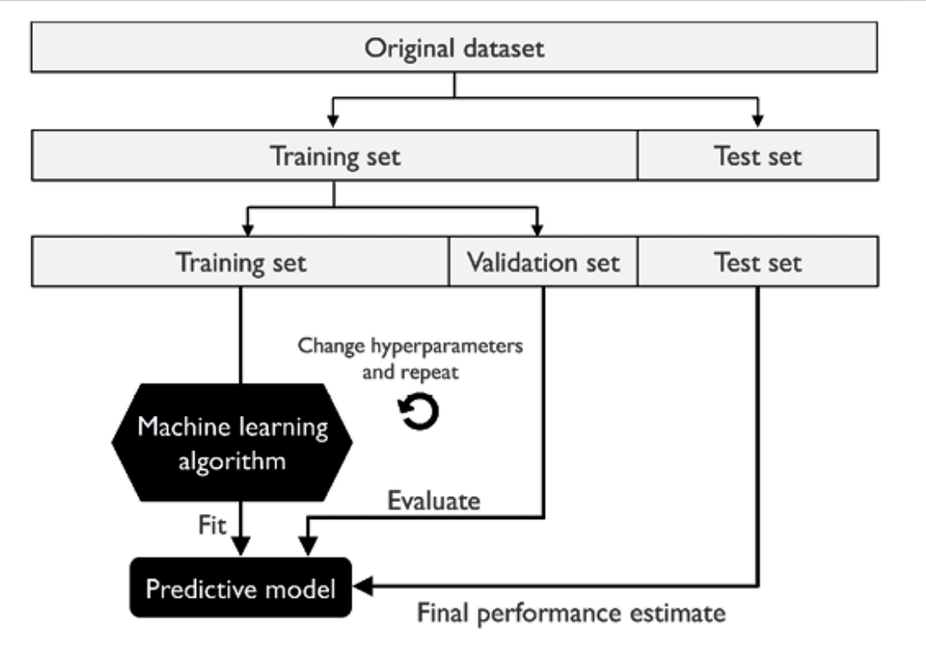

Slide 3
So, when is the skewness too much?
The rule of thumb seems to be:
If the skewness is between -0.5 and 0.5, the data are fairly symmetrical.
If the skewness is between -1 and -0.5(negatively skewed) or between 0.5 and 1(positively skewed), the data are moderately skewed.
If the skewness is less than -1(negatively skewed) or greater than 1(positively skewed), the data are highly skewed.

Slide 4
Train a Model with Amazon SageMaker

Slide 5
Machine Learning with Amazon SageMaker

Slide 6
Deploy a Model on Amazon SageMaker Hosting Services

Slide 7
Get Inferences for an Entire Dataset with Batch Transform

